Slide 1
Introduction to
Data Science
Unit1

Slide 2
What’s in it for me?
Key components in Data Science
Data Science life Cycle
The roles in Data Science Stream
Challenges involved in Data Science Work
Ethics in Data Science

Slide 3
Data Science
“Data Science is a multi-disciplinary set of skills bring together scientific methods, data and software engineering approaches, statistics, and visualization techniques”
COMPETENCY
BENCHMARKING
ASSESSMENT
PROGRAMS

Slide 4
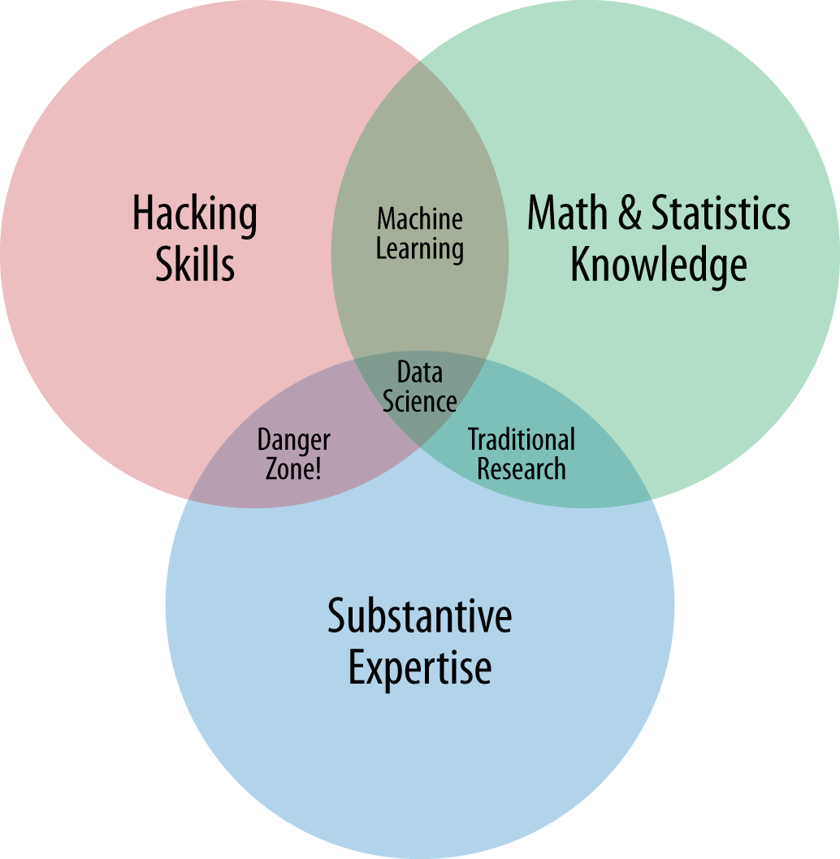
Key components in Data Science

Slide 5

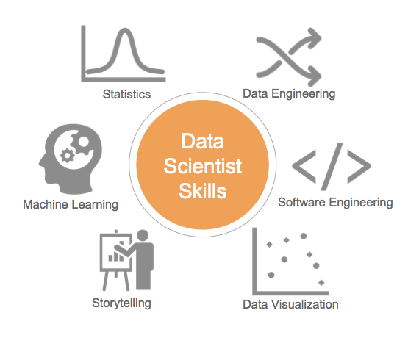
Required skills
Is that practical and possible to expect such a mix of skills?

Slide 6
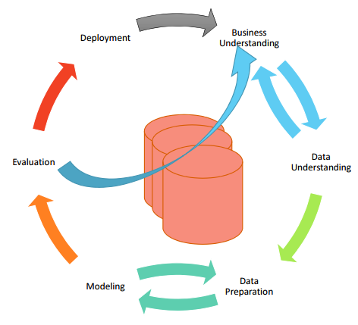
Data Science Life Cycle
Data Generation
Data Collection
Data Exploration
Data Modelling
Model Evaluation
Model Deployment

Slide 7
Roles in Data Science
Data
Science
Team
Data Analyst
Business Analyst
Data Consultant
Data Scientist
Data Architect
Product Architect
Data Science Manager

Slide 8
Challenges involved in Data Science work
Poor Quality Data
Dirty Data, Missing Values, Inadequate Data Size, Poor representation in data sampling
Lack of Understanding
Lack of understanding of data mining techniques
Lack of good literature
Lack of good literature on important data mining techniques and topics
Access to software
Data Variety
Data Velocity
Online machine learning requires models to be constantly updated with new, incoming data
Dealing with huge datasets
Requires Distributed approaches
Coming with right question
More data beats better algorithm , but with smarter questions, you get the right data
Remaining Objective
Getting rid of the preconceived notions on the data
Source: http://info.salford-systems.com/blog/bid/305673/9-Data-Mining-Challenges-From-Data-Scientists-Like-You

Slide 9
Why are these challenges?

Slide 10
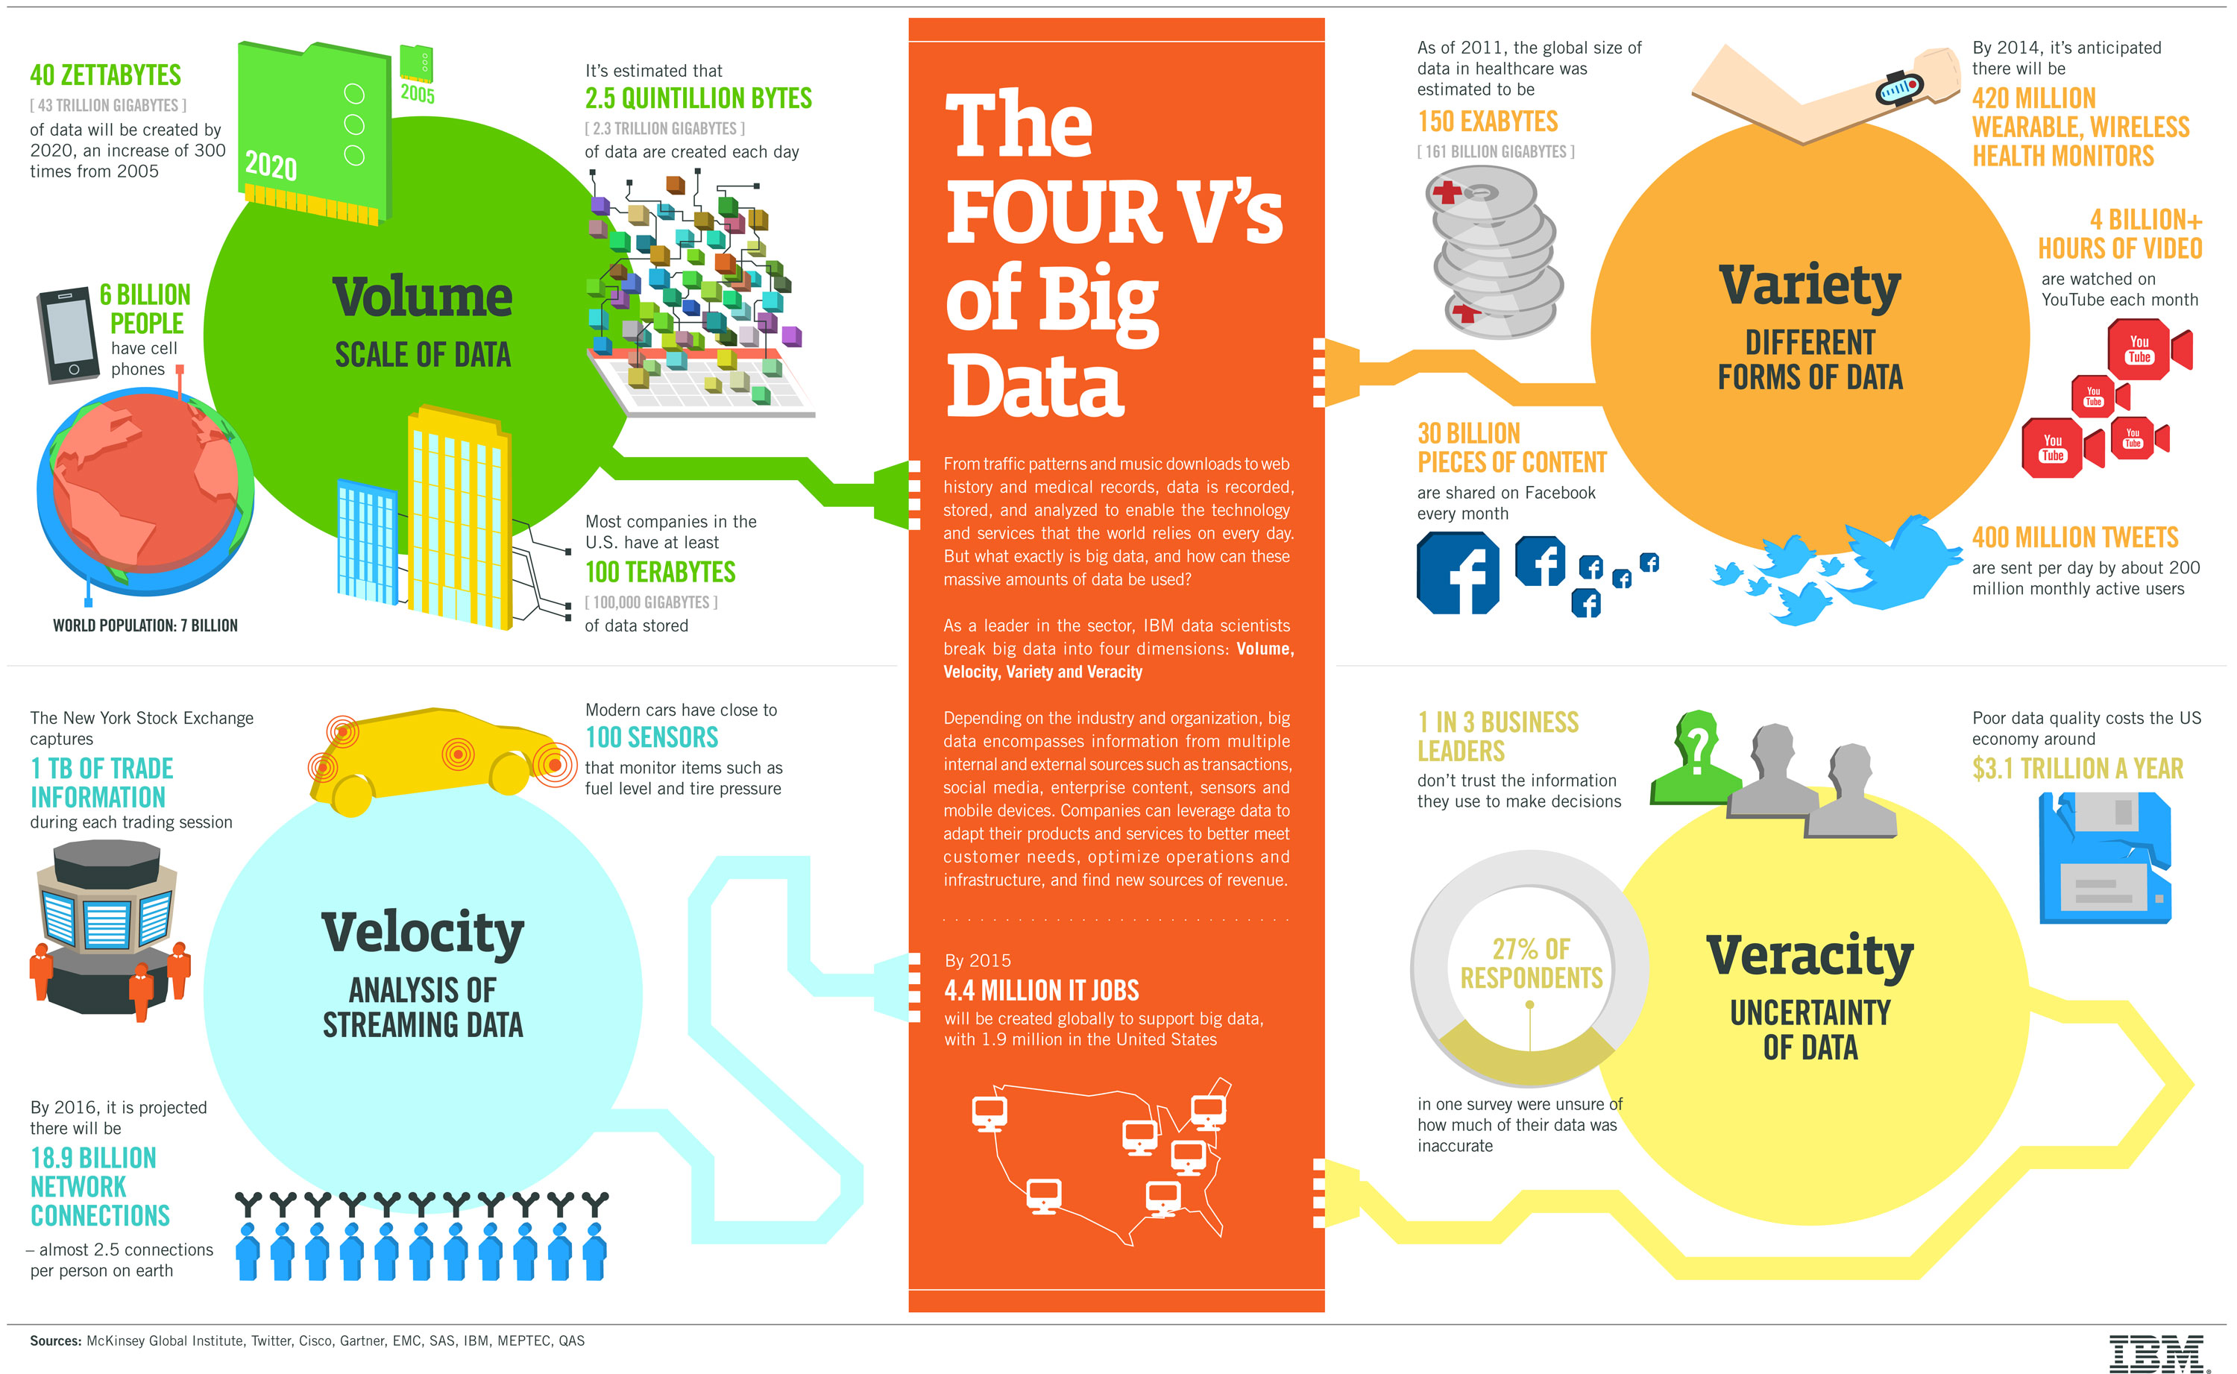
Why are these challenges?

Slide 11
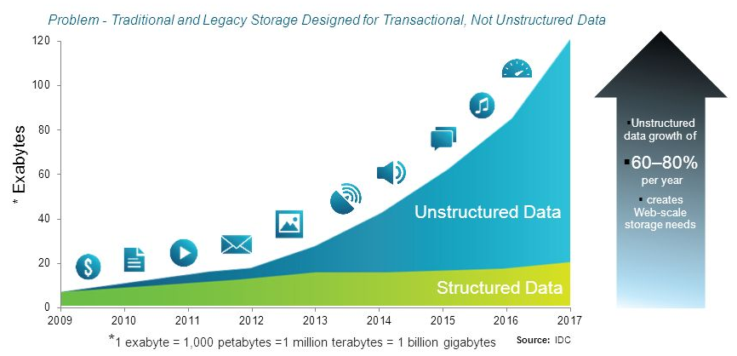
Growth of Unstructured Data
In 1998, Merrill Lynch cited a rule of thumb that somewhere around 80-90% of all potentially usable business information may originate in unstructured form.
Data Growth
IDC and EMC project that data will grow to 40 zettabytes by 2020.
Resulting in a 50-fold growth from the beginning of 2010.
Computer World states that unstructured information might account for more than 70%–80% of all data in organizations.

Slide 12
Ethics in Data Science
According Code of Conduct for DATA SCIENCE CODE OF PROFESSIONAL CONDUCT rules are as follows
Rule 1: Terminology used should be accurate
Example: "Data Quality" means rating the veracity of data
Rule 2: Competent data science professional services must be provided by a data scientist
Ex: Capable Data Science administrations require the learning, expertise, quality and readiness fundamental for the administrations
Rule 3: Collect required amount of Data
Ex: For better data modeling Data Scientist needs data. This required amount of data collection plays
Rule 4: Communication with the client with transparency

Slide 13
Ethics in Data Science
Rule 5: Data Scientist should follow Conflicts of Interest
There is a critical risk that giving data to the Data Scientist exposes the risk of Data. Data Scientist should not reveal the output or disclose the data to any other Client or Outsiders.
Rule 6: Data Scientist should have follow duties to Prospective Client

Slide 14
What is Business Analytics?
Analytics is the use of:
data,
information technology,
statistical analysis,
quantitative methods, and
mathematical or computer-based models
to help managers gain improved insight about their business operations and make better, fact-based decisions.

Slide 15
What is Business Analytics?
Importance of Business Analytics
There is a strong relationship of BA with:
- profitability of businesses
- revenue of businesses
- shareholder return
BA enhances understanding of data
BA is vital for businesses to remain competitive
BA enables creation of informative reports

Slide 16
Business Application of Analytics
How?
How Netflix recommend you a movie?
How does metro trains are scheduled during Olympics?
How does bank decide to give you loan or not?
How does the price of Air ticket changes from time?
How does your email account filter the mail as spam?

Slide 17
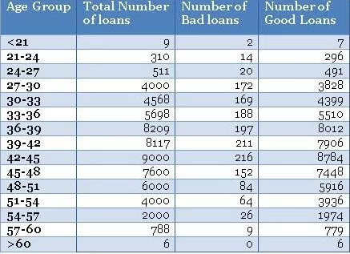
Case Studies
Banking Case Study Example – Risk Management
Assume you are the chief risk officer (CRO) for bank that has
disbursed 60816 auto loans in the quarter between April–June.
You have noticed a bad rate of around 2.5% or 1524 bad loans
out of total 60816 disbursed loans.
You want to analyze the bad rate across several individual
variables.
You have a hunch based on your experience that borrower’s age
at the time of loan disbursal is a key distinguishing factor for bad
rates.
Therefore, you have divided the loans based on the age of the
borrowers and created a table something like this:

Slide 18
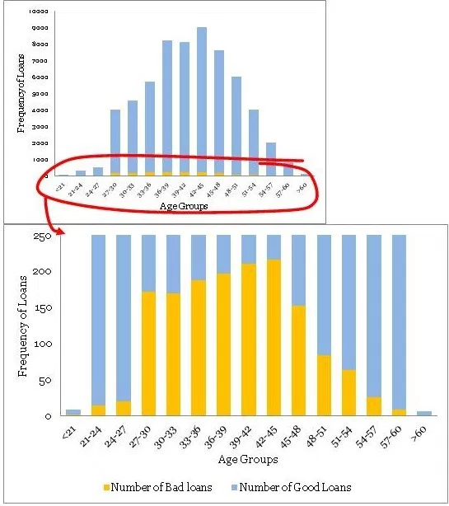
Using the table, you have created a histogram and
zoomed into the area of interest (close to the bad
loans) like this:
So what are your observations from this graph:
The maximum bad loans are in the age bucket 42 to 45 years.
Does it mean the risk is also the highest in this bucket?
The maximum loans are also in the bucket 42 to 45 years.
The data is really thin on the fringe buckets (i.e. <21 and >60 years groups) with only 9 and 6 data points.

Slide 19
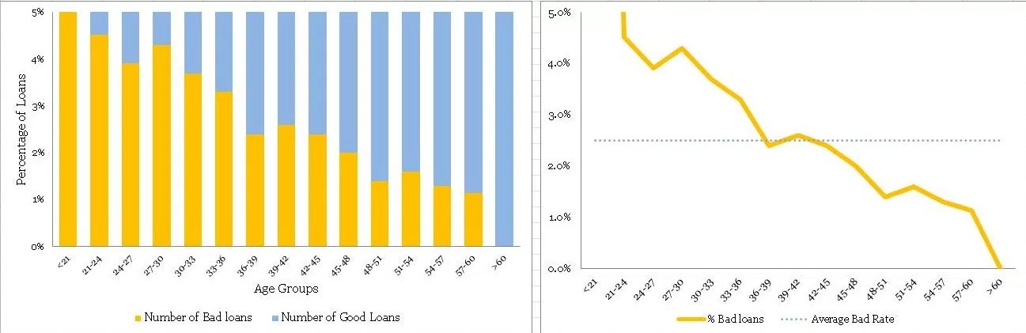
Lets create a Normalized Plot

Slide 20
There is a definite trend in terms of the bad rates and the age groups.
As the borrowers are getting older, they are less likely to default on their loans.
The fringes (i.e. <21 and >60 years groups) have thin data, this information cannot be obtained from the normalized plot.
A handy rule of thumb is to have at least 10 records of both (good & bad) cases before taking the information seriously – otherwise, it is not statistically significant.

Slide 21
Learning from Case study?
Drill down the insight
Take a good sample size
Its always good to visualize your outcome.

Slide 22
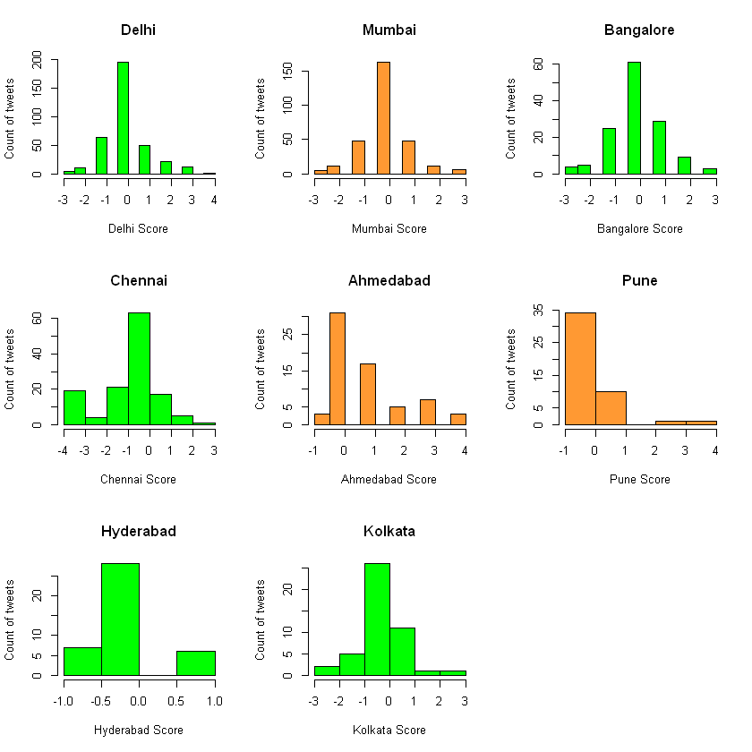
Let’s quickly look at few more examples
Public Sentiment on GST
Even the Non-BJP states are showing positive response to GST.

Slide 23
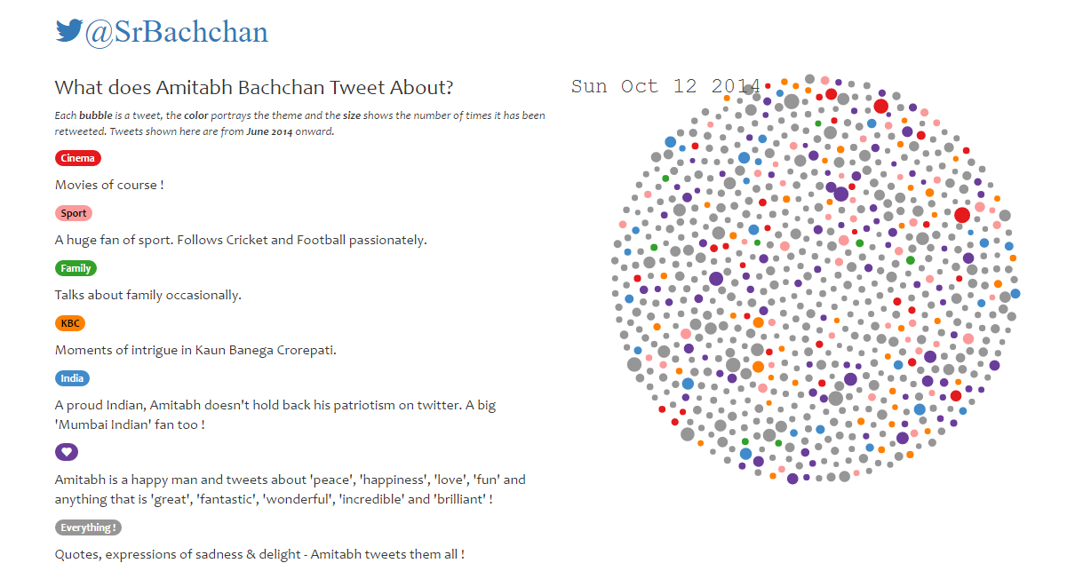
What is that Big B is tweeting?

Slide 24
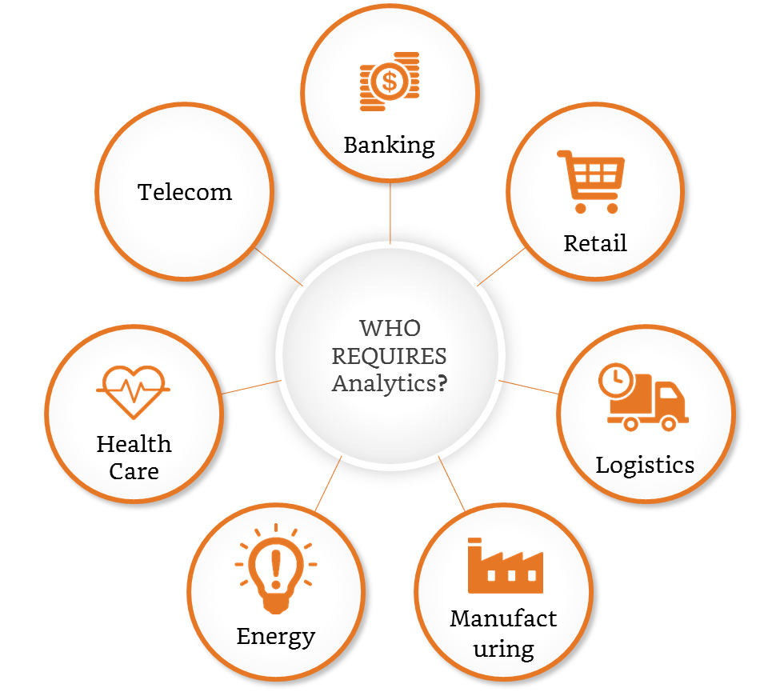
Where all analytics is needed?

Slide 25
Scope of Business Analytics
Descriptive
Predictive
Prescriptive
Discover patterns
“What happened?”
Trending Analysis, Correlations, crosstabs, outliers, distribution etc
Forecast future
“What could happen?”
Regression, clustering, time series forecasting etc
Suggest actions
“What should be done?”
Recommendation systems, artificial intelligence etc

Slide 26
Let me give your some examples
Example:- Retail Markdown Decisions
Most department stores clear seasonal inventory by reducing prices.
The question is:
When to reduce the price and by how much?
Descriptive analytics: examine historical data for similar products (prices, units sold, advertising, …)
Predictive analytics: predict sales based on price
Prescriptive analytics: find the best sets of pricing and advertising to maximize sales revenue

Slide 27
Data for Business Analytics
Structured
Highly Organized / Modelled
Data in ProLearn CRM
Data
Semi - Structured
Data with mix of formatted and non-formatted data
Facts for Analysis
Emails
Un - Structured
Can’t be readily classified
Photos, Songs, Videos, PPTs

Slide 28
Data typology
Data
Qualitative
Steven’s Typology
Dates
Quantitative
Continuous
Location
Text
Nominal
Ordinal
Interval
Ratio
Discrete

Slide 29
Steven’s Typology
Nominal variable, is for mutual exclusive, but not ordered, categories.
Gender of Candidate (M/F/T)
A ordinal variable, is one where the order matters but not the difference between values.
Rank in Office
A interval variable is a measurement where the difference between two values is meaningful but can not explain ZERO.
Movie rating
A ratio variable, has all the properties of an interval variable, and also has a clear definition of ZERO.
Pulse Rate

Slide 30
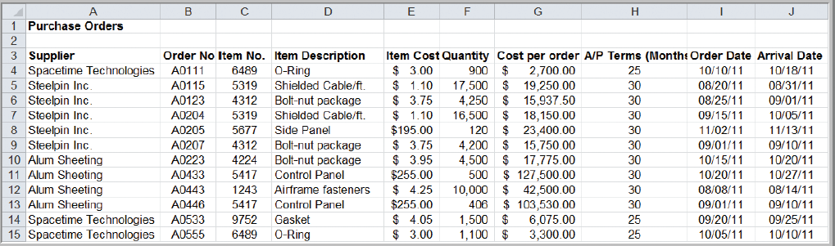
Classifying Data Elements in a Purchasing Database
Ratio
Ratio
Ratio
Ratio
Date
Date
Categorical
Categorical
Categorical
Categorical

Slide 31
Problem Solving and decision making
BA represents only a portion of the overall problem solving and decision-making process.
Six steps in the problem-solving process
1. Recognizing the problem
2. Defining the problem
3. Structuring the problem
4. Analyzing the problem
5. Interpreting results and making a decision
6. Implementing the solution

Slide 32
Recognizing the Problem
Problems exist when there is a gap between what is happening and what we think should be happening.
For example, costs are too high compared with competitors.

Slide 33
Defining the Problem
Clearly defining the problem is not a trivial task.
Complexity increases when the following occur:
- large number of courses of action
- several competing objectives
- external groups are affected
- problem owner and problem solver are not the
same person
- time constraints exist

Slide 34
Structuring the Problem
Stating goals and objectives
Characterizing the possible decisions
Identifying any constraints or restrictions

Slide 35
Analyzing the Problem
Identifying and applying appropriate Business Analytics techniques
Typically involves experimentation, statistical analysis, or a solution process

Slide 36
Interpreting Results and Making a Decision
Managers interpret the results from the analysis phase.
Incorporate subjective judgment as needed.
Understand limitations and model assumptions.
Make a decision utilizing the above information.

Slide 37
Implementing the Solution
Translate the results of the model back to the real world.
Make the solution work in the organization by providing adequate training and resources.

Slide 38
Future of Business Analytics
AI - Replika - APP
Deep Learning – Amazon go
Process Automation

